Slide 1
Introduction Session

Slide 2
Agenda
Overview of Data Science & Artificial Intelligence Field
Roadmap of Course
Code of Conduct
Career Opportunities
Essentials of a Trained & Certified Data Scientist Resume
LinkedIn Profile Building
Overview of Placement Process
Learning Management System
Software Installation

Slide 3
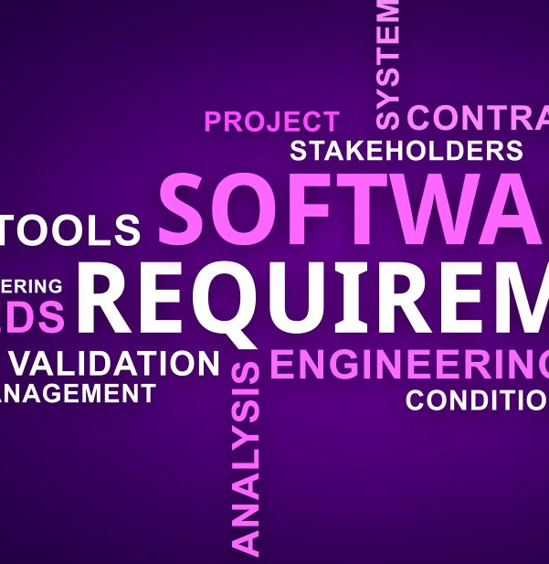
Overview of Data Science & Artificial Intelligence Field

Slide 4
Overview of Data Science & Artificial Intelligence Field
Welcome to the world of Data Science and Artificial Intelligence (AI)! This course offers a comprehensive understanding of these transformative fields, covering definitions, historical context, key components, applications, challenges, and future prospects.
Overview
Interdisciplinary Fields: Data Science and AI are pivotal in technology and data-driven decision-making, providing a blend of scientific methods and intelligent systems
Definitions
Data Science: Involves scientific methods to extract insights from structured and unstructured data, covering data collection, cleaning, analysis, modeling, and visualization.
Artificial Intelligence: Encompasses machine learning, deep learning, natural language processing, and computer vision to create intelligent machines

Slide 5
Cont…
Historical Context
Understand the origins, from AI pioneers like Alan Turing to the emergence of Data Science in the 21st century.
Key Components
Data Science: Equips you with essentials like data collection, preprocessing, analysis, modeling, and visualization, using Python, R, statistical techniques, and machine learning algorithms.
Artificial Intelligence: Introduces machine learning techniques, deep learning, natural language processing, and computer vision, along with practical applications

Slide 6
Cont…
Application
Explore real-world applications across industries, showcasing the impact of Data Science and AI in areas like business, healthcare, autonomous vehicles, and virtual assistants.
Challenges
Understand challenges related to data quality, privacy, bias in AI algorithms, and ethical concerns for making informed decisions.
Future Directions
Discuss future prospects, including automation, decision support systems, transparency in AI, ethical considerations, and the pursuit of Artificial General Intelligence (AGI).

Slide 7
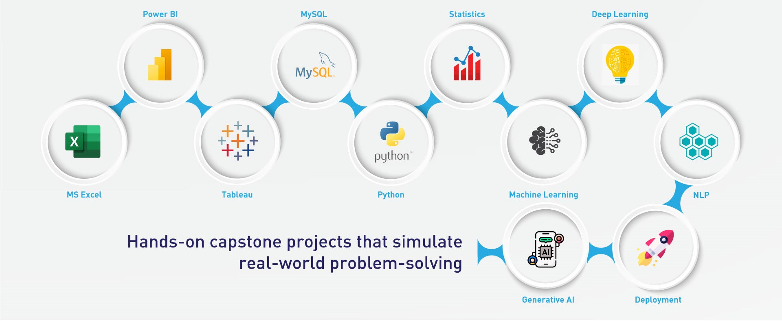
Course Roadmap

Slide 8
Code of Conduct
In order to be eligible for 100% Placement Assistance, ALL of the below conditions must be met:
Must have 75% ATTENDANCE in all technical training sessions, soft skills sessions, aptitude prep sessions, mock interviews (technical and HR), interview preparatory sessions, and guest/industry sessions organized by the CEC.
Must have submitted the Capstone Project as per the timelines and scored a MINIMUM OF A OR B GRADE in the Capstone Project Presentation conducted by THE INSTITUTE Head Office.
Must have paid the entire fee in time.
Must have appeared for all the Interview and Test opportunities presented/offered.
Must have followed BIA® Student Code of Conduct and Terms & Conditions.
https://www.bostoninstituteofanalytics.org/terms-and-conditions

Slide 9
Career Opportunities
Data Science Roles for Trained & Certified Data Science & Artificial Intelligence Freshers
Data Scientist
Business Analyst
Data Analyst
Python Developer
Tableau Developer
Power BI Developer
Machine Learning Engineer
AI & ML Engineer
Data Visualization Analyst
NLP Engineer
Computer Vision Engineer
AI Ethics Consultant
Research Scientist
Data Science and AI Educator

Slide 10
Cont…
Top Industries Hiring Data Scientists in 2024
BFSI
Media & Entertainment
Healthcare
Retail
Manufacturing
Telecommunications
Cybersecurity
Oil & Gas

Slide 11
Resume Building
What is a resume?
A resume is not just a Summary of your academics & work history. A resume is an Advertisement that helps you sell yourself to an Employer.
Resume is a true depiction of your
Personality
Background
Capabilities
Accomplishments
How Organized you are
Your sense of quality

Slide 12
Essentials of a Trained & Certified Data Scientist Resume
Name and contact information.
Career Objective
Work Experience
Projects
Skills
Education
Awards or Recognition

Slide 13
LinkedIn Profile Building
LinkedIn tips for students & fresh graduates​
Upload an appropriate photo
Write an informative but punchy profile headline.
Summary
Be smart about your experience.
Complete additional profile sections tailored to career starters
Volunteer Experience
Honors and Awards
Build a strong network
Claim your unique LinkedIn URL
Show don’t just tell: Share your work
Use keywords in adding skills you can be endorsed for and get a few recommendations

Slide 14
Overview of Placement Process
Mandatory registration on CEC portal: www.bostoninstituteofanalytics.org/cec/registration
Use correct BATCH ID provided by Campus Coordinator.
Upload resume in prescribed format.
Ensure accurate information on CEC portal; misleading info leads to disqualification.
Placement process: Receive email from Campus Coordinator, confirm application before deadline.
Shortlisted students proceed through Aptitude Test, Technical/Coding Test, HR Interview, Final Discussion.

Slide 15
Overview of Placement Process
Rounds can be in-person or online; check emails regularly for updates.
Results, feedback, and corrective steps shared via email/phone.
Eligibility conditions: 75% attendance, submit Capstone Project, pay fees on time, attend all interviews/tests, follow Code of Conduct.
Attend interview prep sessions for better chances.
Formal dress code for all interviews, even video; share offer letter with the Institute.
No-shows lead to immediate debarment; no rescheduling of interviews/tests.
CEC assistance ends upon receiving the first offer letter

Slide 16
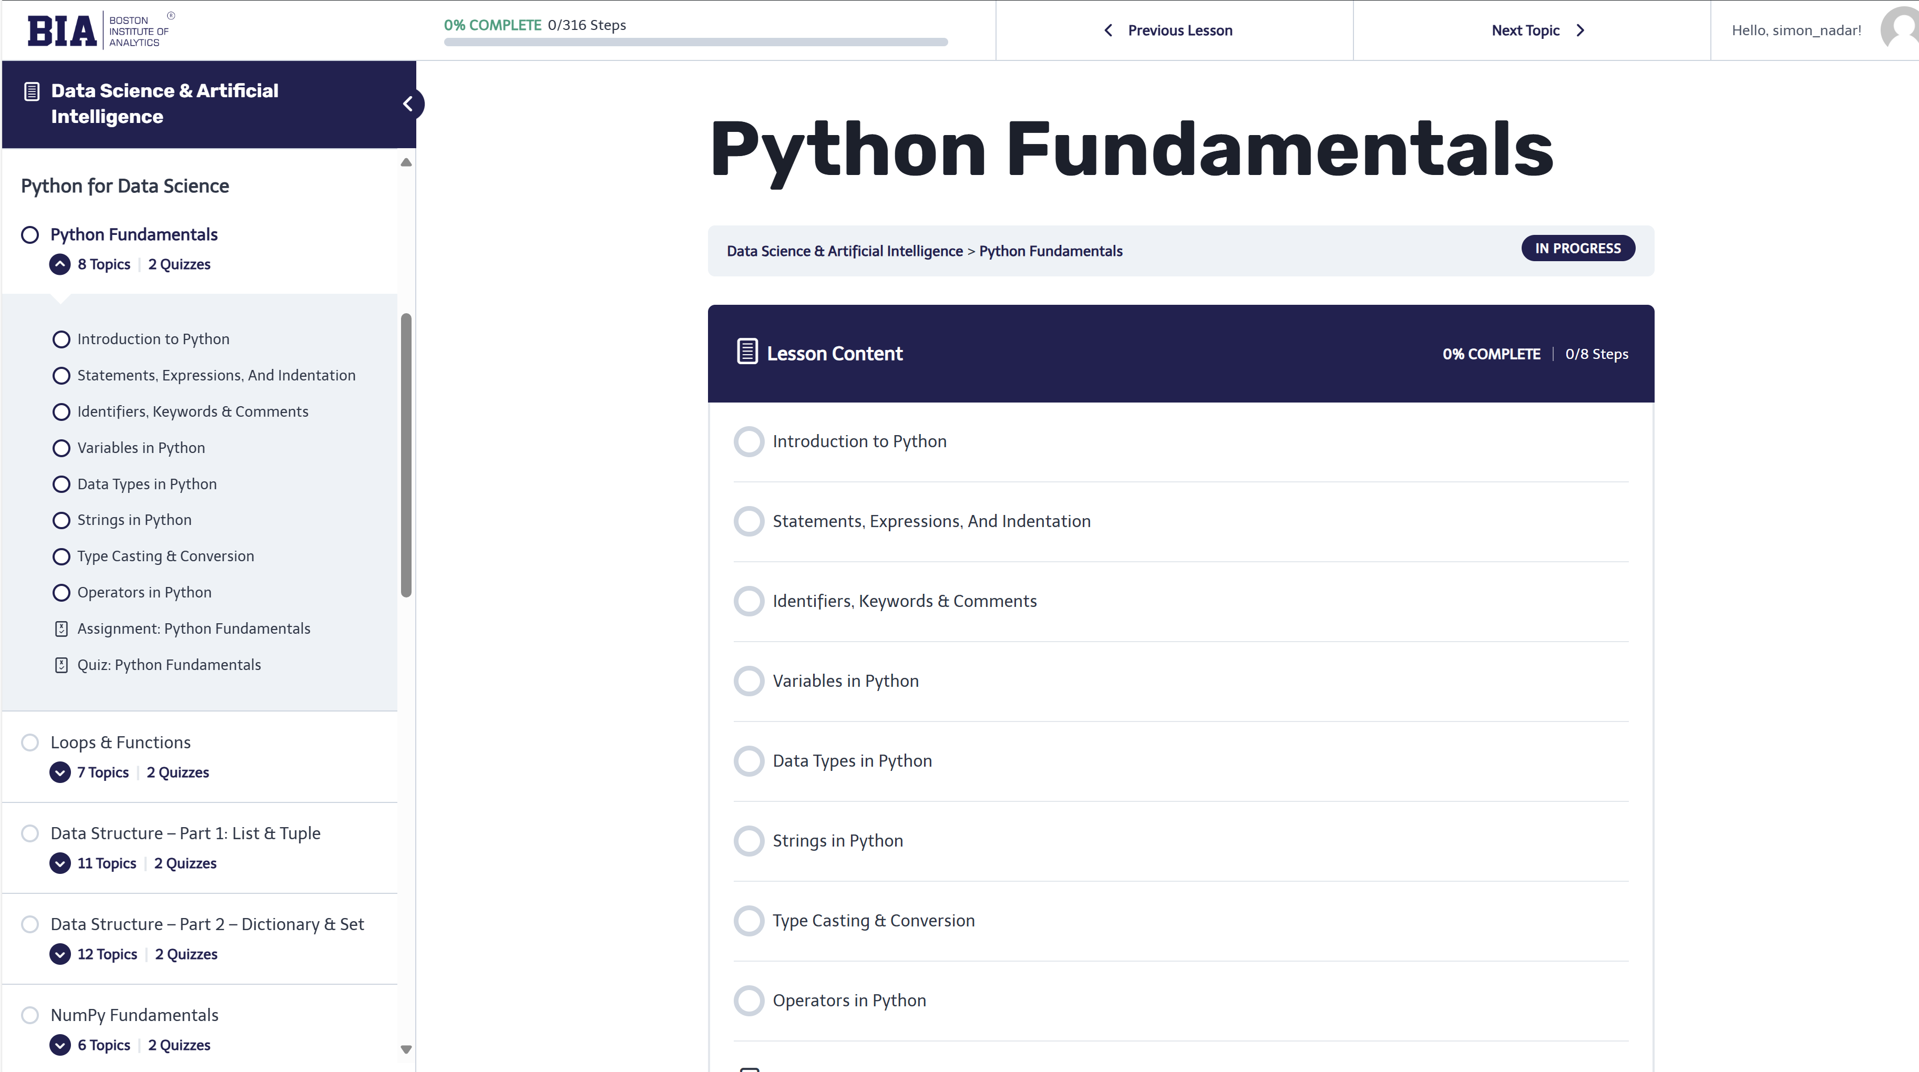
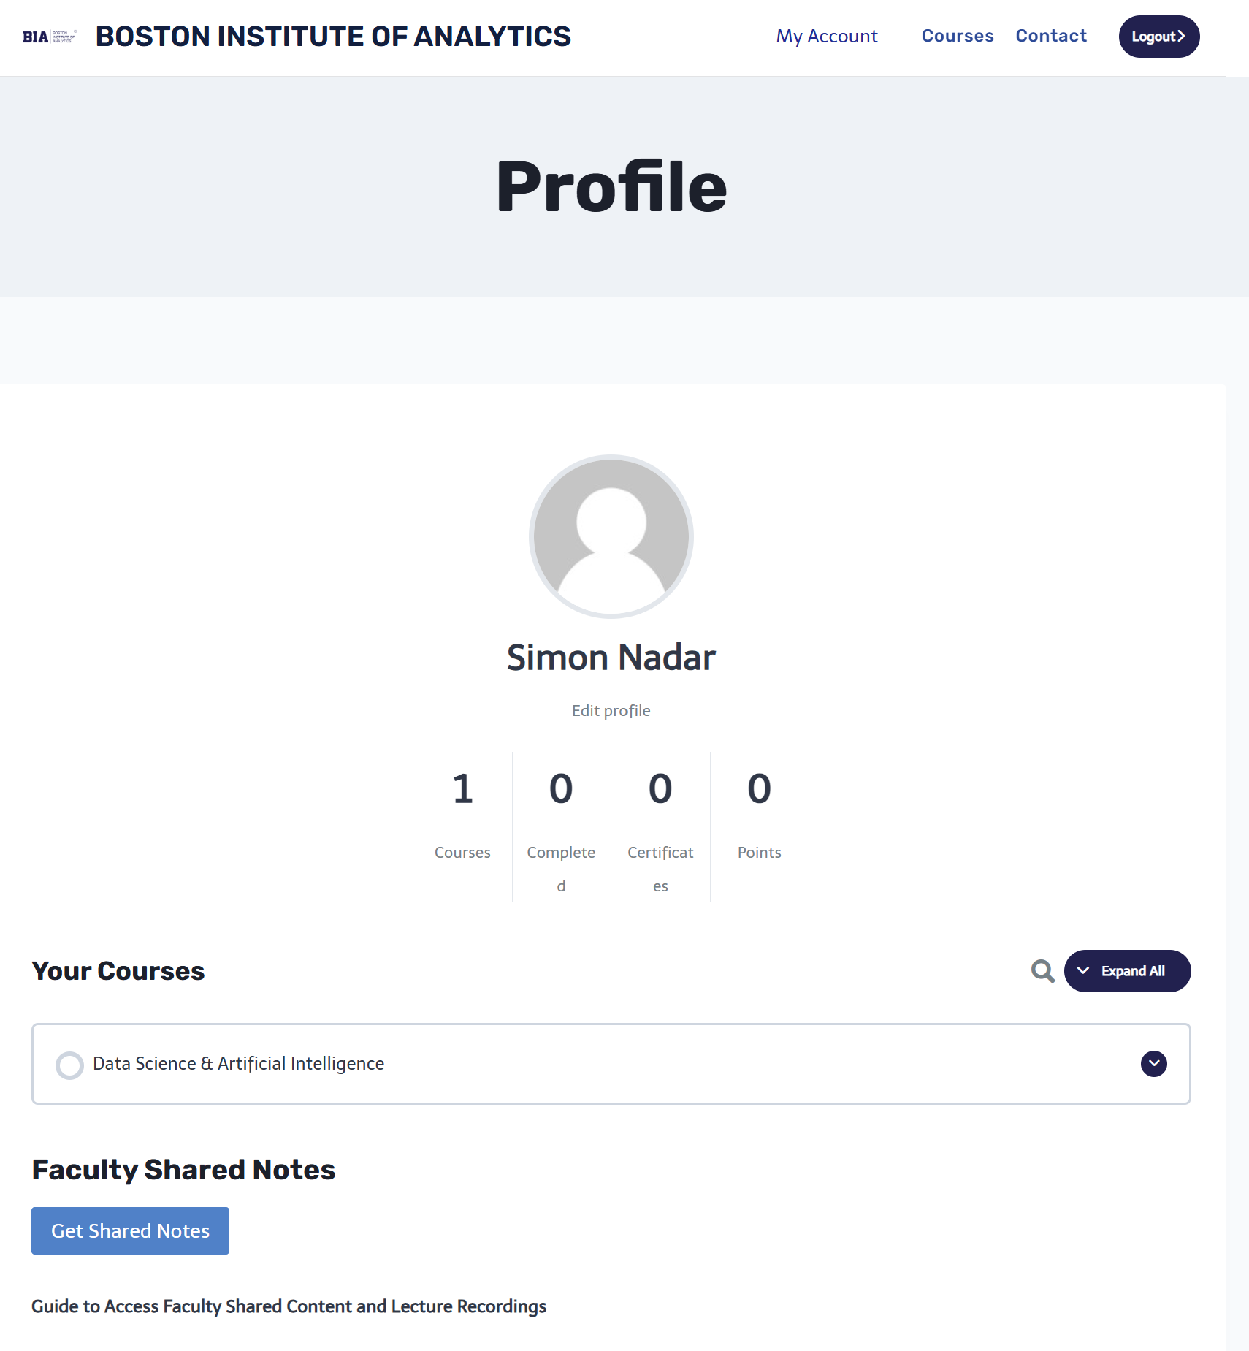
Learning Management System

Slide 17
Learning Management System
LMS Course Components:
Class Content:
Comprehensive lectures and study materials covering core topics in Data Science and AI.
Interactive modules to facilitate understanding of complex concepts.
Class Exercises:
Hands-on practice exercises to reinforce theoretical knowledge.
Real-world problem-solving scenarios to enhance practical skills.
Quizzes:
Regular quizzes to assess understanding and retention of course materials.
Instant feedback to help students identify areas for improvement.

Slide 18
Learning Management System
LMS Course Components:
4. Assignments:
Detailed assignments designed to deepen knowledge and application of Data Science and AI concepts.
Projects that encourage critical thinking and problem-solving.
5. Capstone Projects:
Comprehensive projects that integrate and apply all learned skills.
Real-world problems requiring innovative and practical solutions.

Slide 19
Learning Management System
LMS Access Instructions
Email Notification:
Students will receive an email notification once added to the batch.
This email contains a link to reset your password.
Click on the link in the email to reset your password and gain access to the LMS.
Important Note:
If you do not receive the email, please check your Spam/Junk Email folder.
If the email is not found in the Spam/Junk folder, contact your course coordinator for assistance.
Certification Requirements:
Students must complete all above-mentioned components within the LMS.
Successful completion of all exercises, quizzes, assignments, and capstone projects is mandatory for certification.

Slide 20
System & Software Requirements

Slide 21
System & Software Requirements
System Requirements
RAM – 4 GB and above
Hard Disk Space – 250 GB and above
Software Requirement
Microsoft Excel
Python
Anaconda
Git
MySQL
Microsoft Power BI Desktop
Tableau

Slide 22


Microsoft Excel

Slide 23
Microsoft Excel
What is Microsoft Excel?
Microsoft Excel is a spreadsheet program that allows you to organize, analyze, and visualize data.
How to Install
Visit the official Microsoft Office website: Microsoft Office.
Choose the edition you want (Microsoft Office or Microsoft 365) based on your needs and budget.
Click the "Buy Now" or "Subscribe" button and follow the on-screen instructions.
Once purchased, you will be able to download and install Microsoft Excel.

Slide 24


Python

Slide 25
Python
What is Python?
Python is a versatile and popular programming language used for a wide range of applications, including web development, data analysis, and automation.
How to Install
Visit the official Python website: Python Downloads.
Download the latest version of Python for your operating system (Windows, macOS, or Linux). You should see a button with "Download Python."
Run the downloaded installer.
During installation, make sure to check the box that says "Add Python x.x to PATH" to make it easier to use Python from the command line.
Follow the installation wizard's instructions to complete the installation

Slide 26
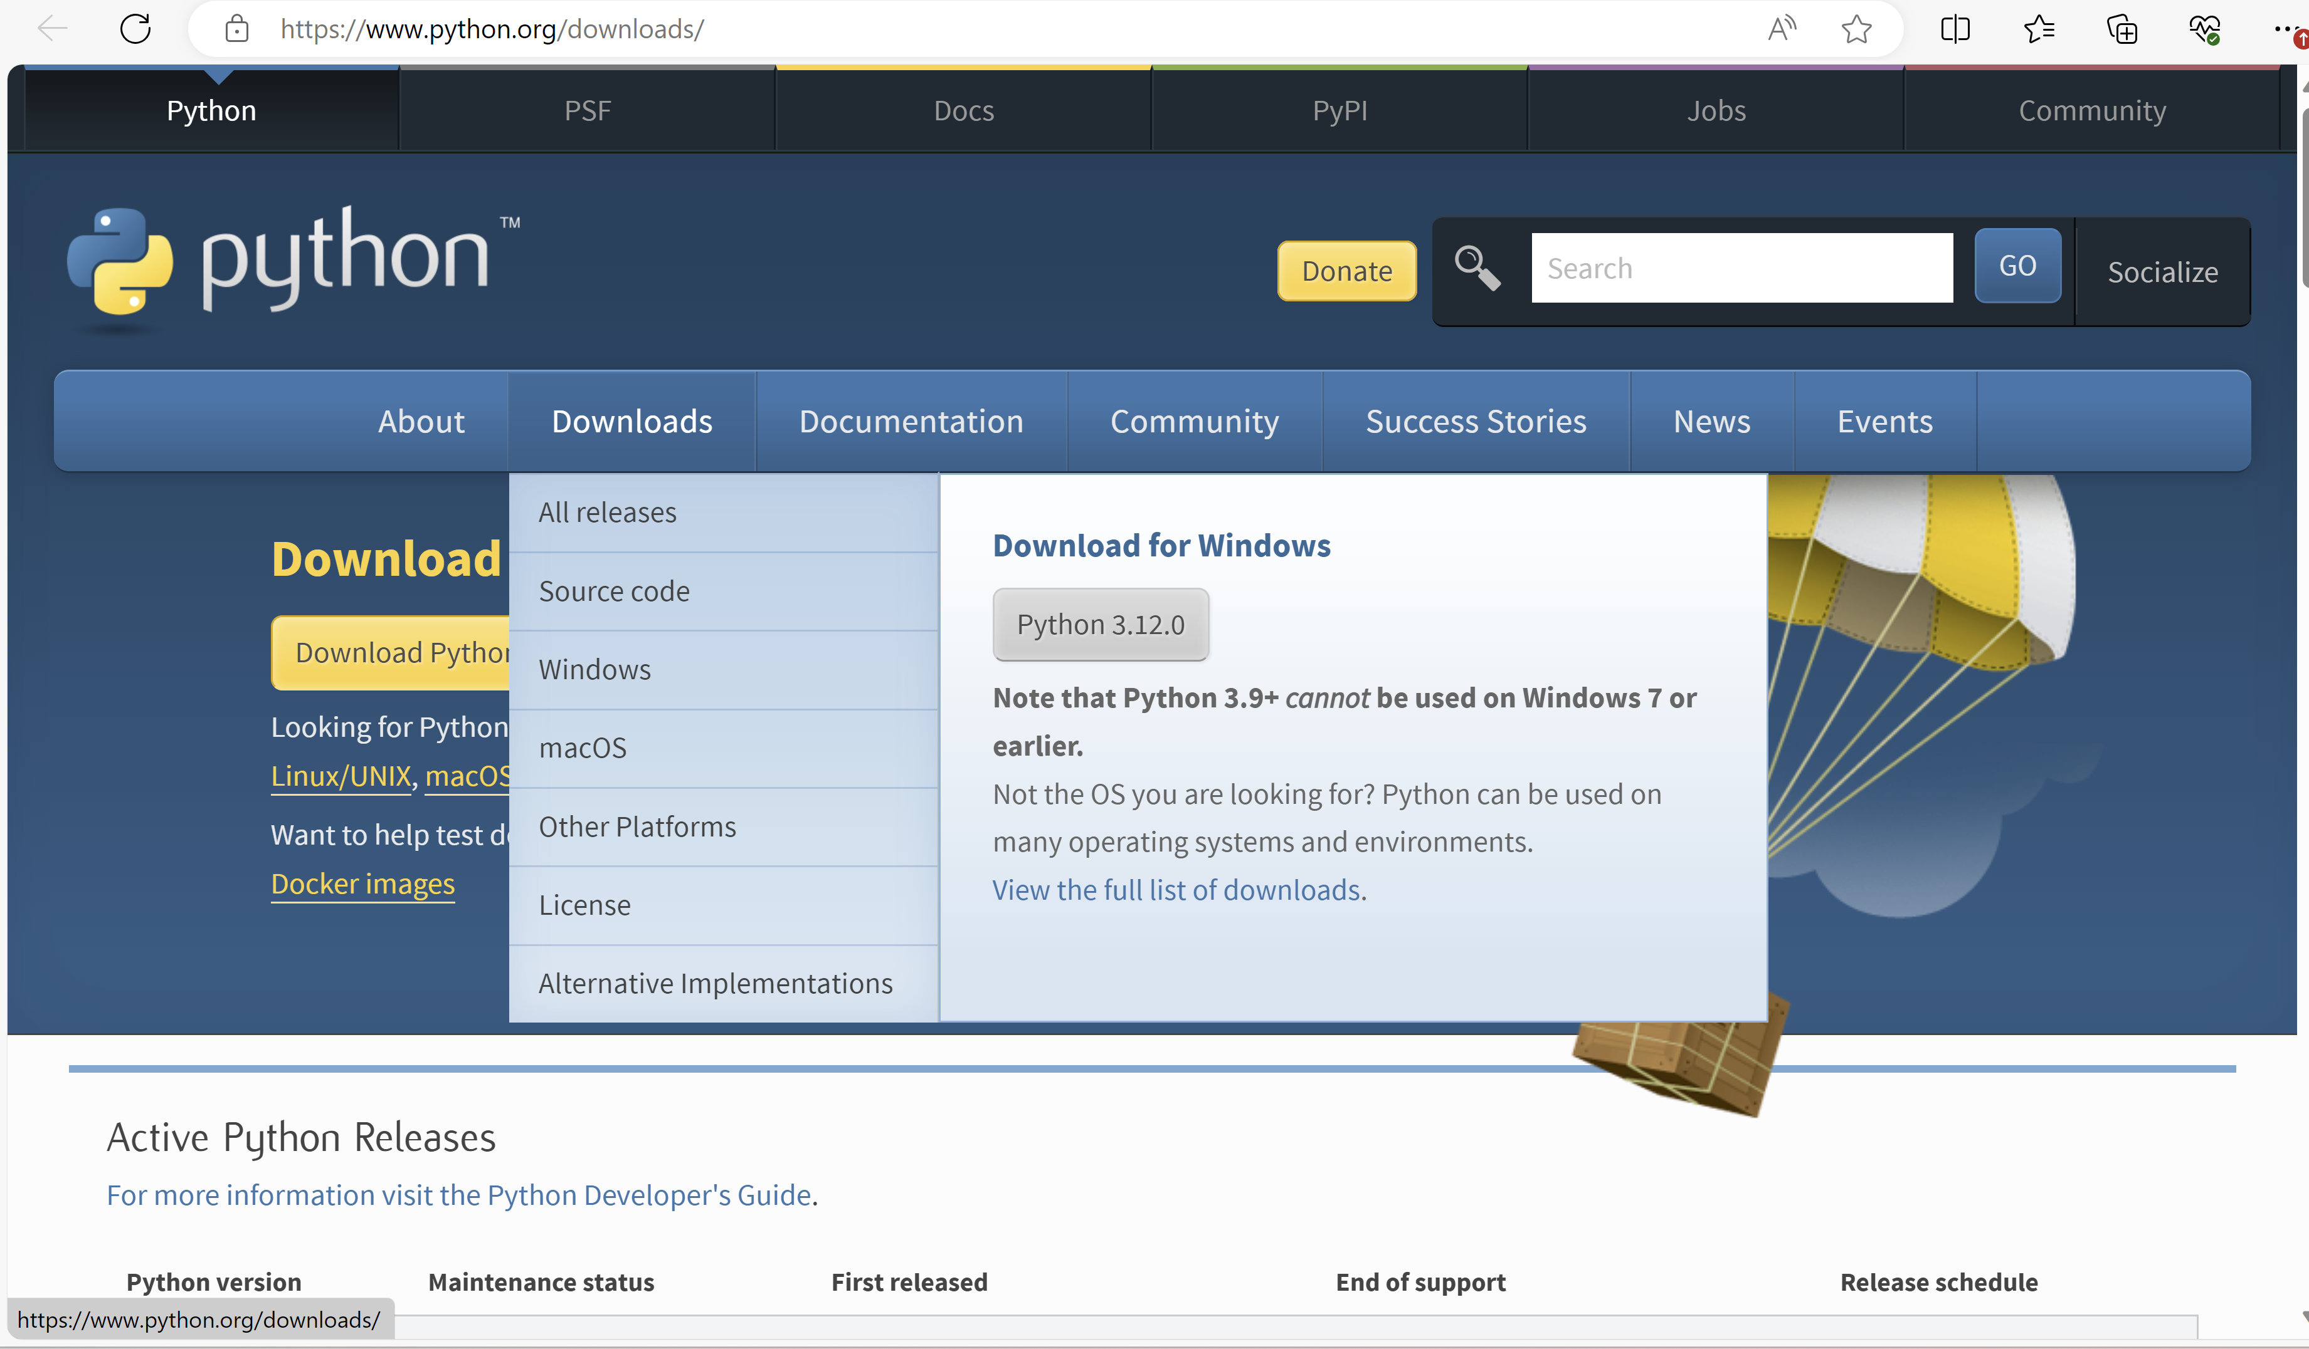
Python

Slide 27
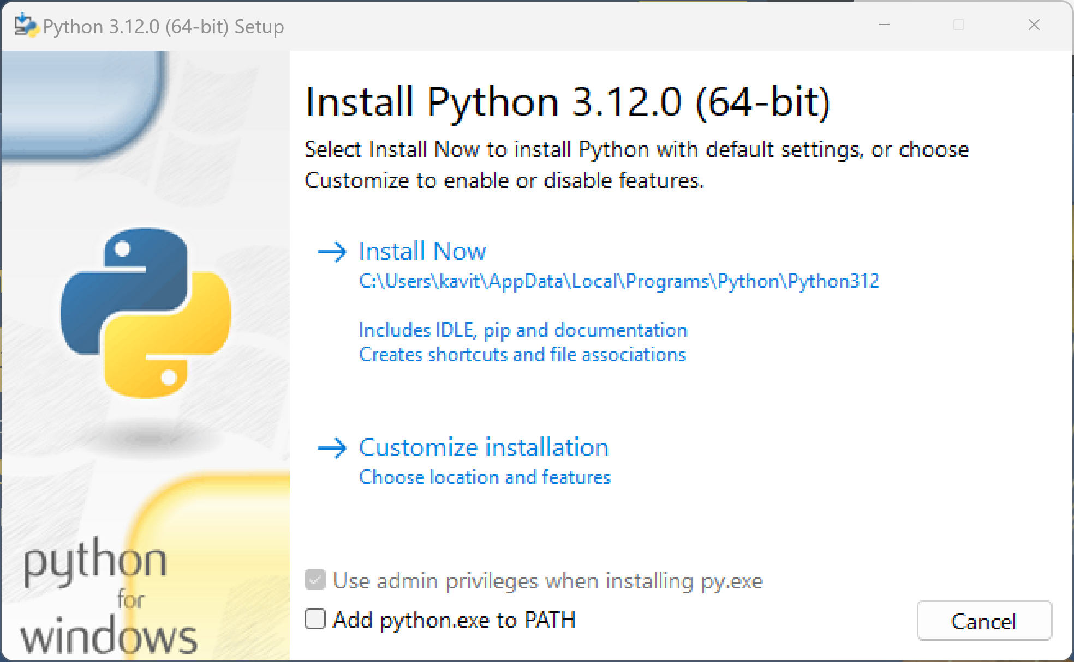
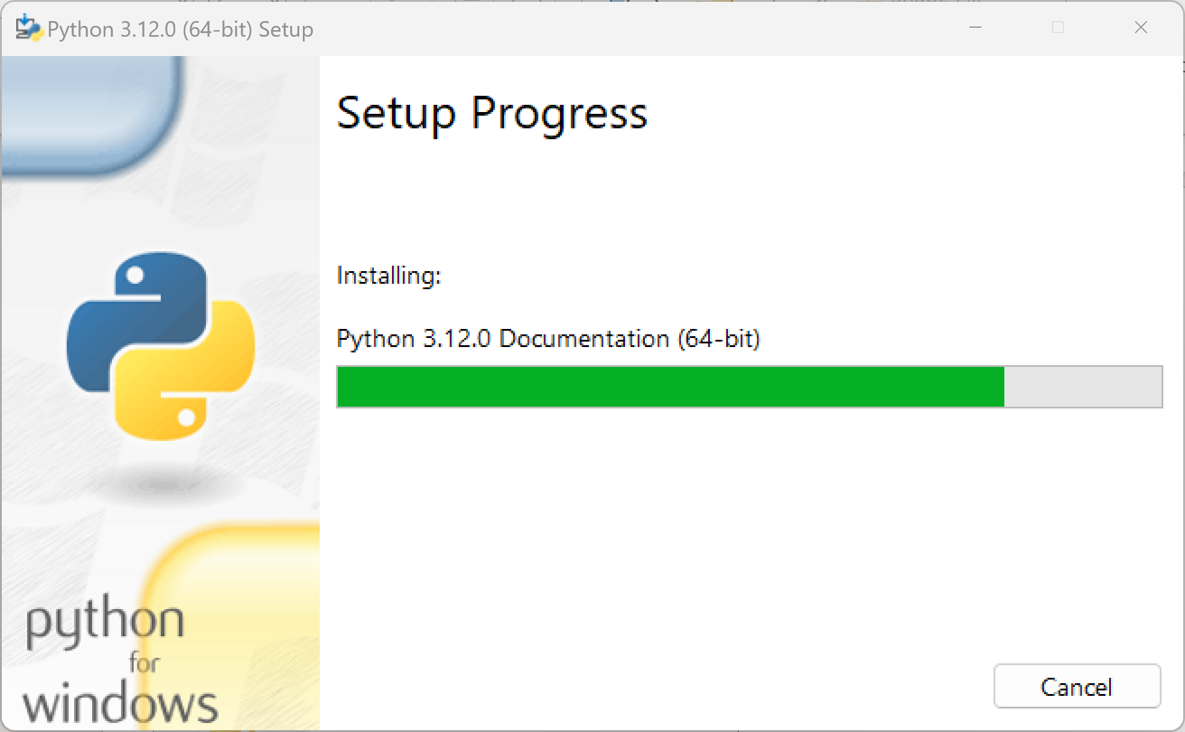
Cont…

Slide 28


Anaconda Navigator

Slide 29
Anaconda Navigator
What is Anaconda?
Anaconda is a Python distribution that includes popular data science libraries and tools, making it great for data analysis and machine learning.
How to Install
Visit the Anaconda download page: Anaconda Download.
Choose the "Anaconda Individual Edition" based on your operating system (Windows, macOS, or Linux).
Download the Anaconda installer.
Run the installer and follow the installation instructions. You can accept the default settings

Slide 30
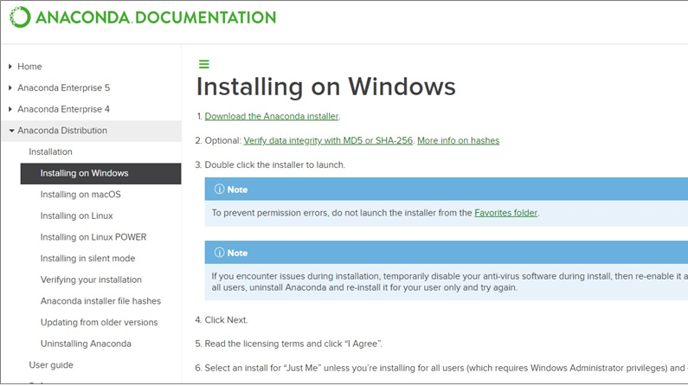
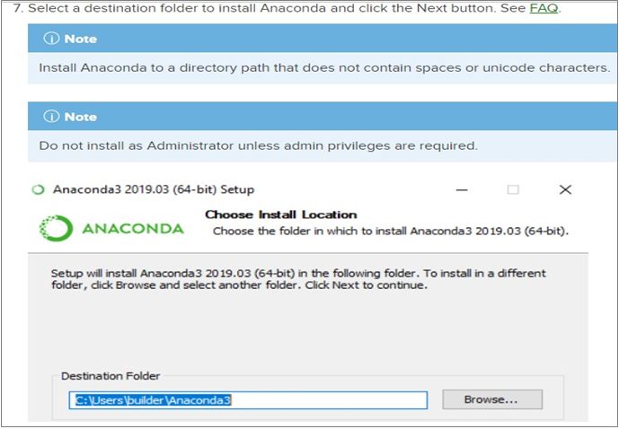
Cont…
Installation of Anaconda (1 of 6)
Installation of Anaconda (2 of 6)

Slide 31
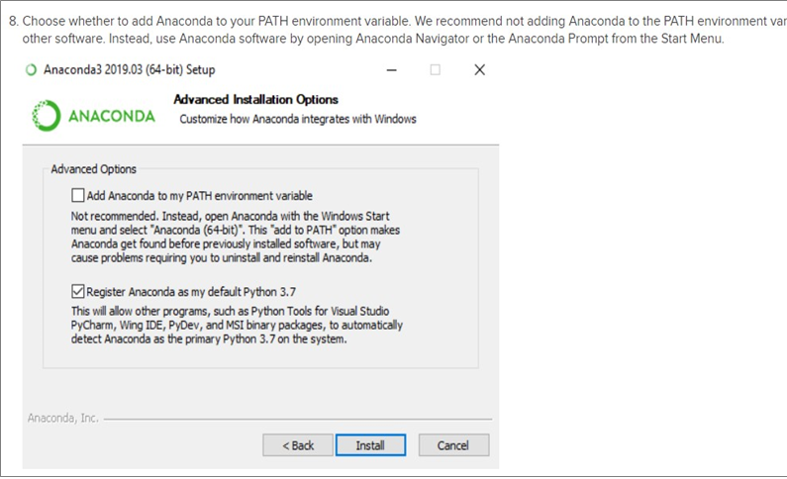
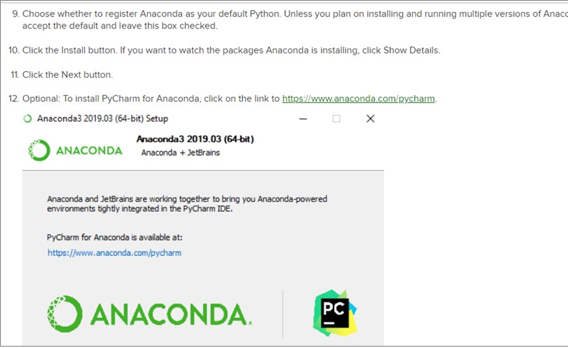
Cont…
Installation of Anaconda (3 of 6)
Installation of Anaconda (4 of 6)

Slide 32
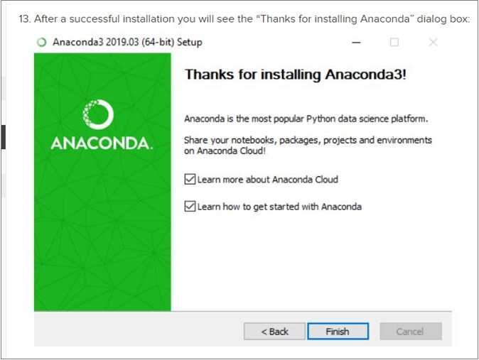
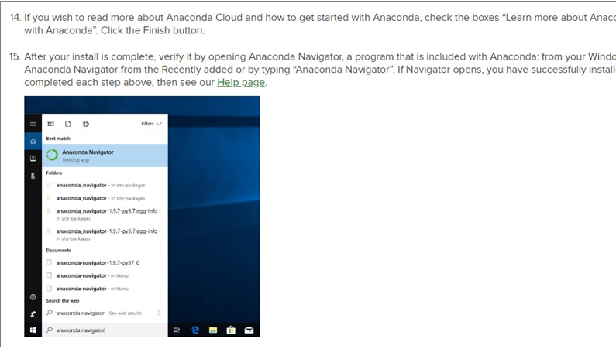
Cont…
Installation of Anaconda (5 of 6)
Installation of Anaconda (6 of 6)

Slide 33



Git & GitHub

Slide 34
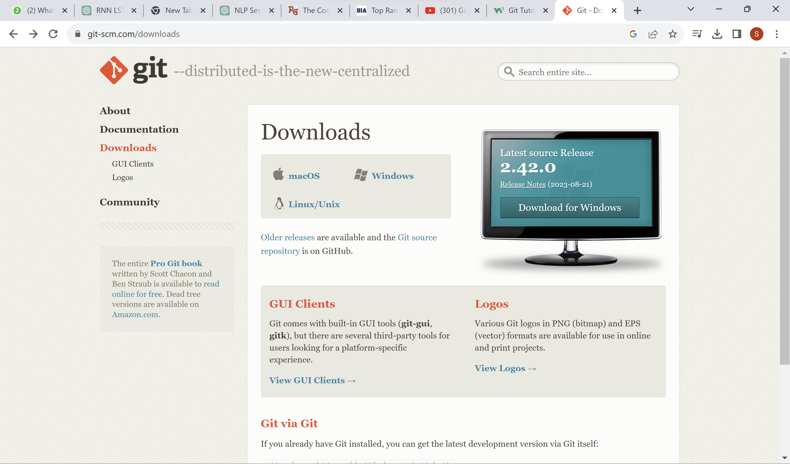
Cont…
Git is a version control system.
Git helps you keep track of code changes.
Git is used to collaborate on code.
Download & Install
https://git-scm.com/downloads

Slide 35
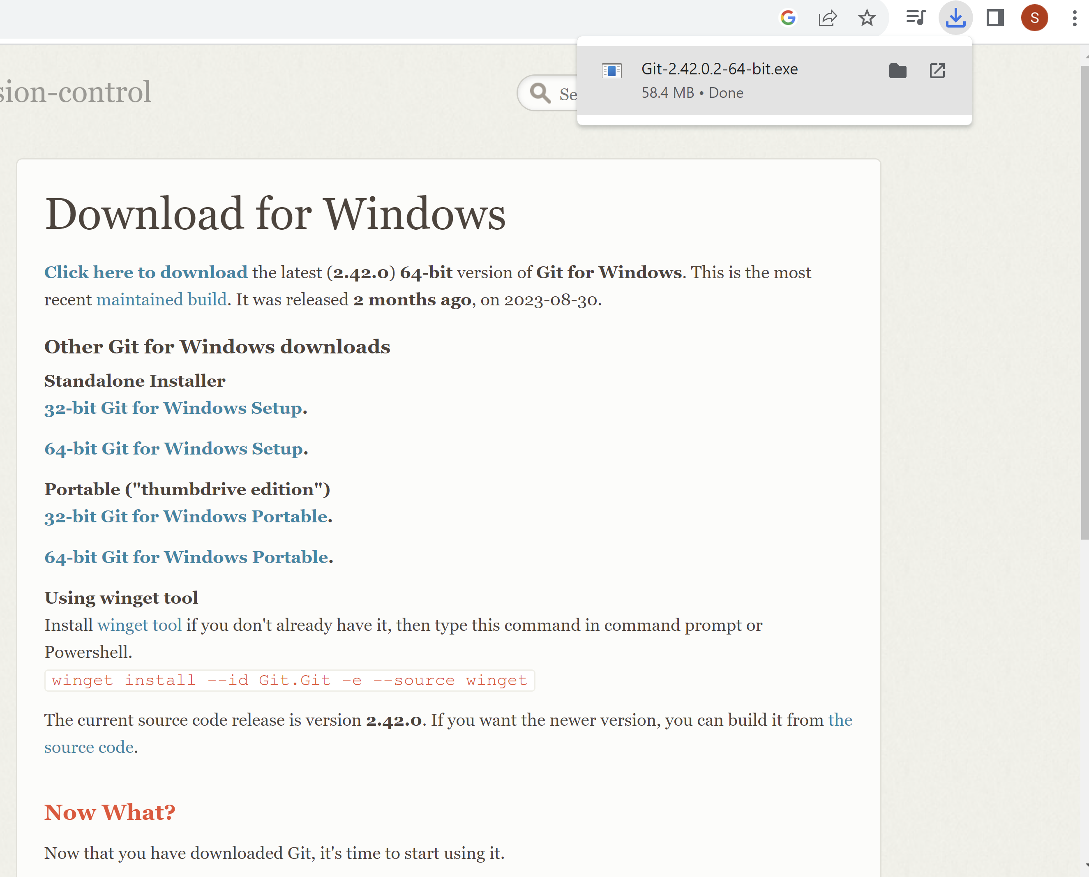
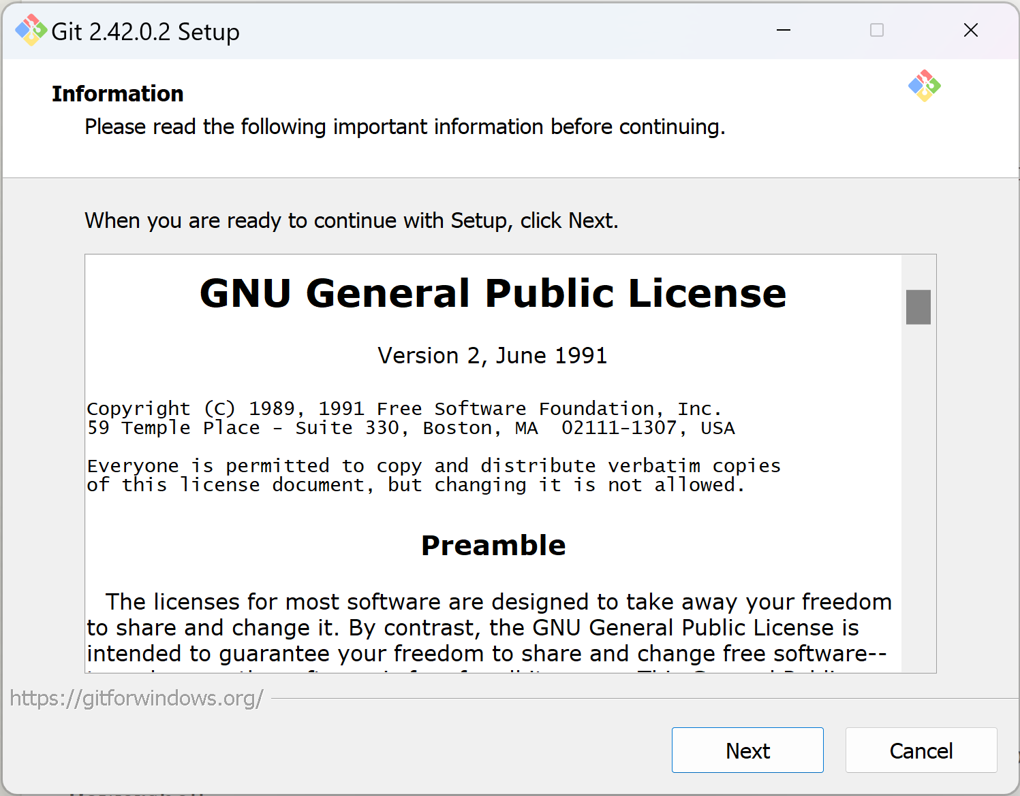
Cont…

Slide 36
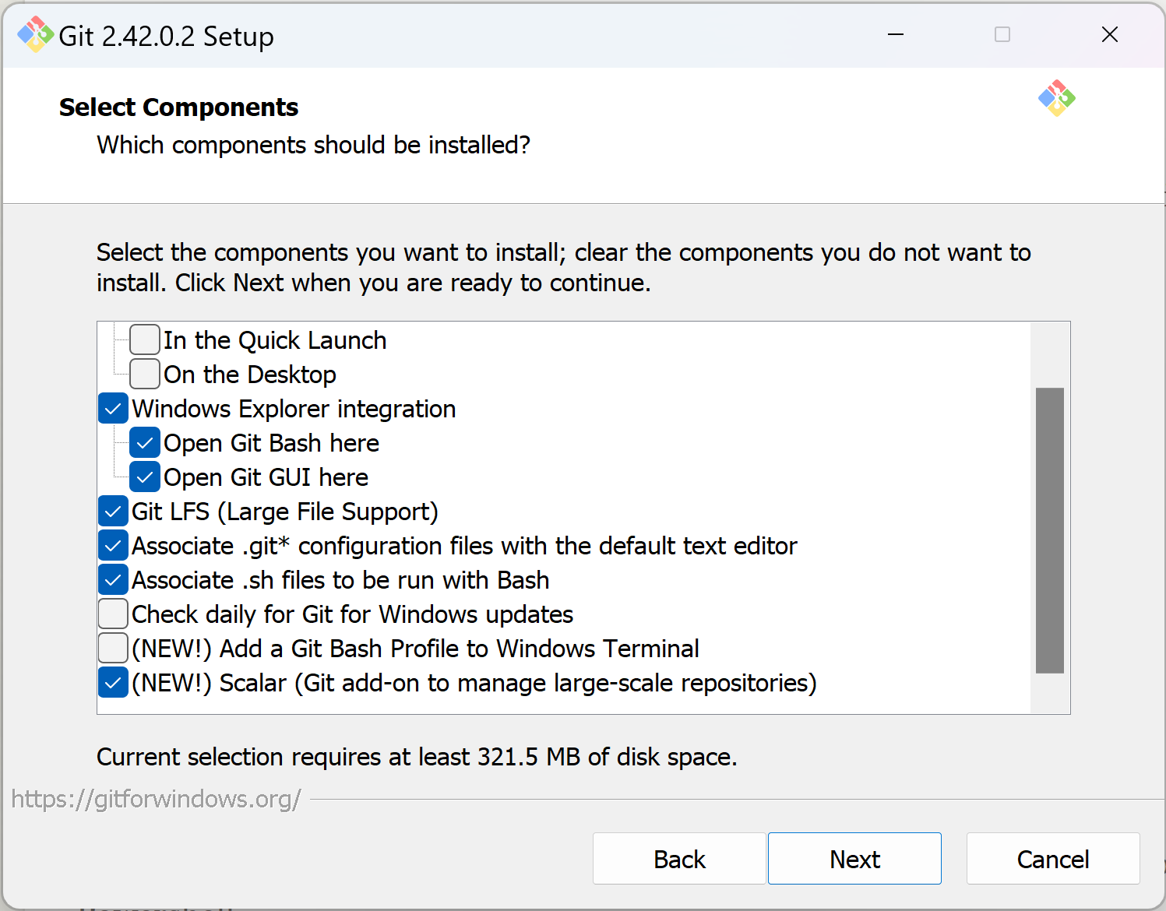
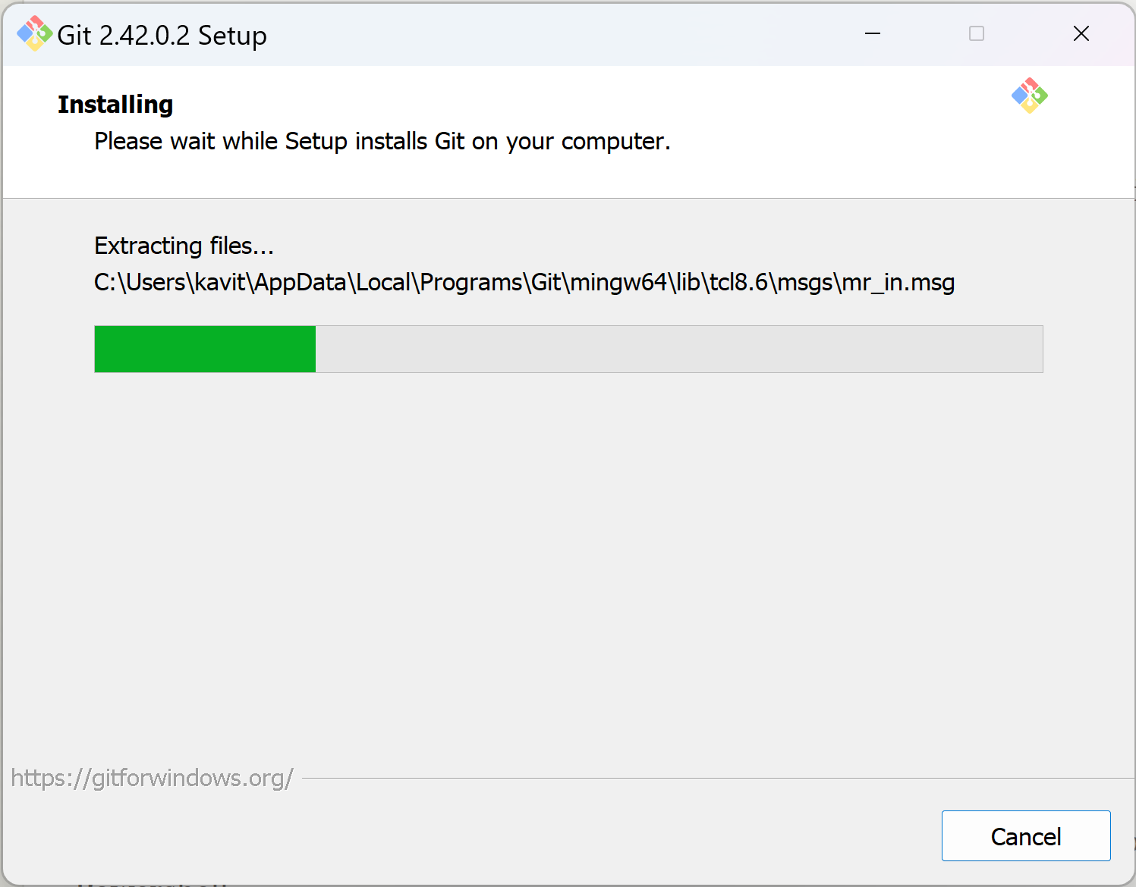
Cont…

Slide 37


MySQL

Slide 38
MySQL
What is MySQL?
MySQL is a relational database management system used to store and manage data.
How to Install
Go to the official MySQL website: MySQL Downloads.
Choose the appropriate MySQL Community Server version for your operating system.
Download the installer.
Run the installer and follow the installation instructions. You'll set a root password during the installation process

Slide 39
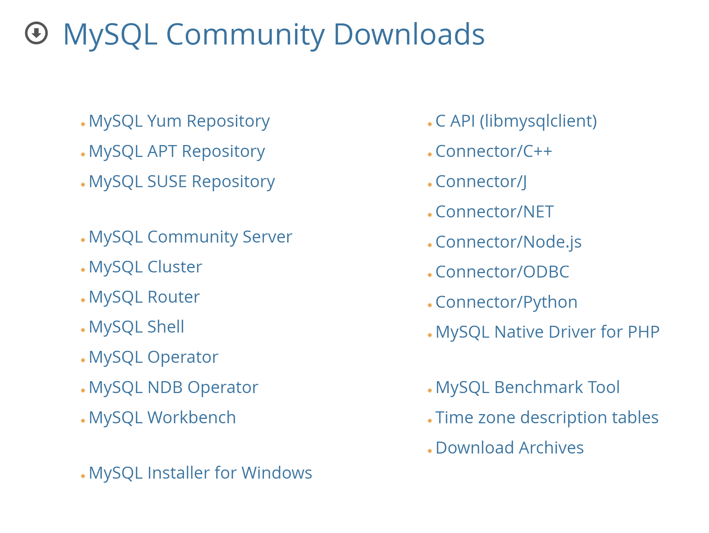
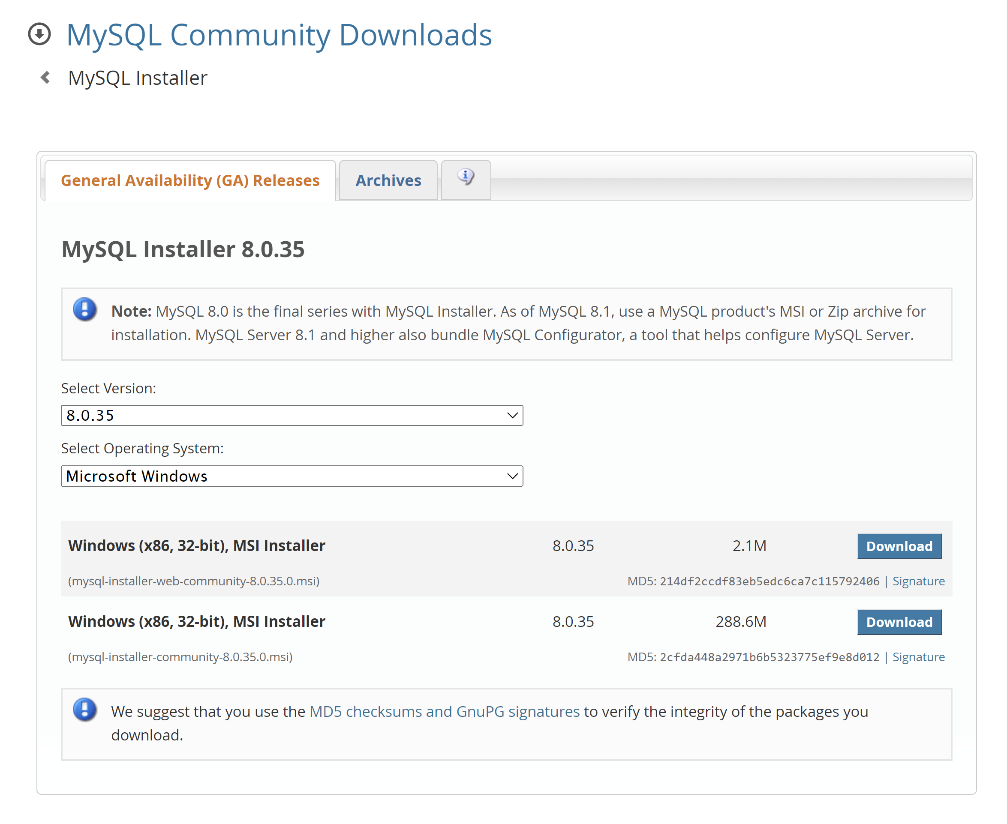
Cont…

Slide 40
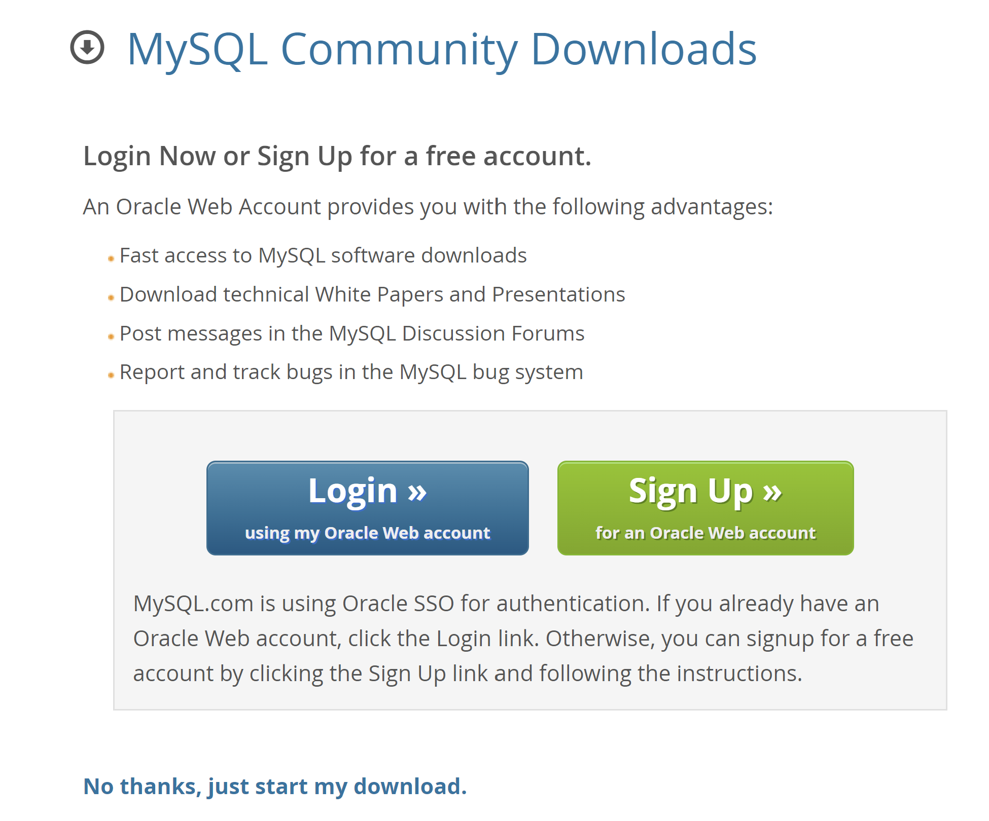
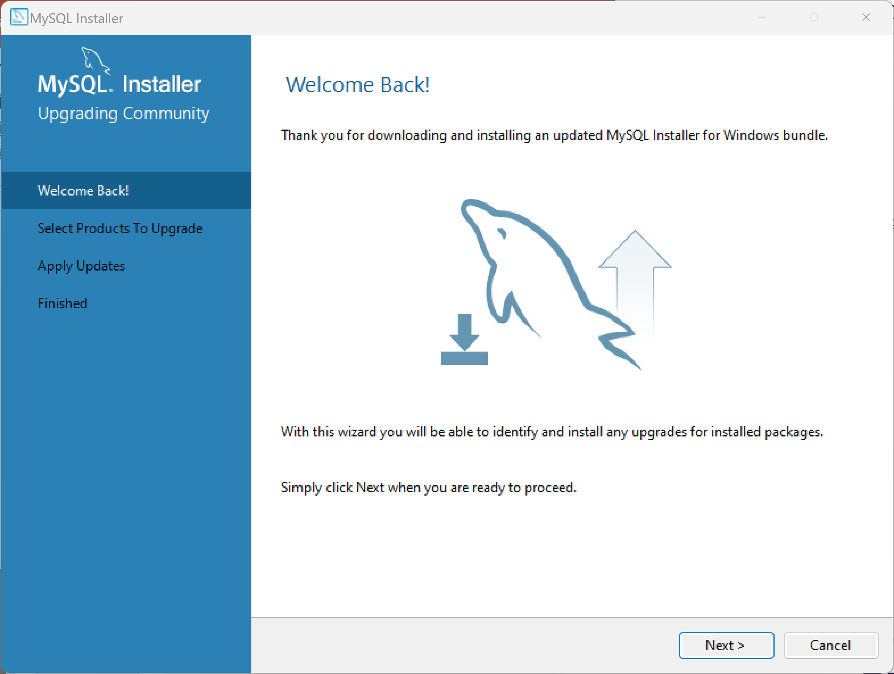
Cont…

Slide 41
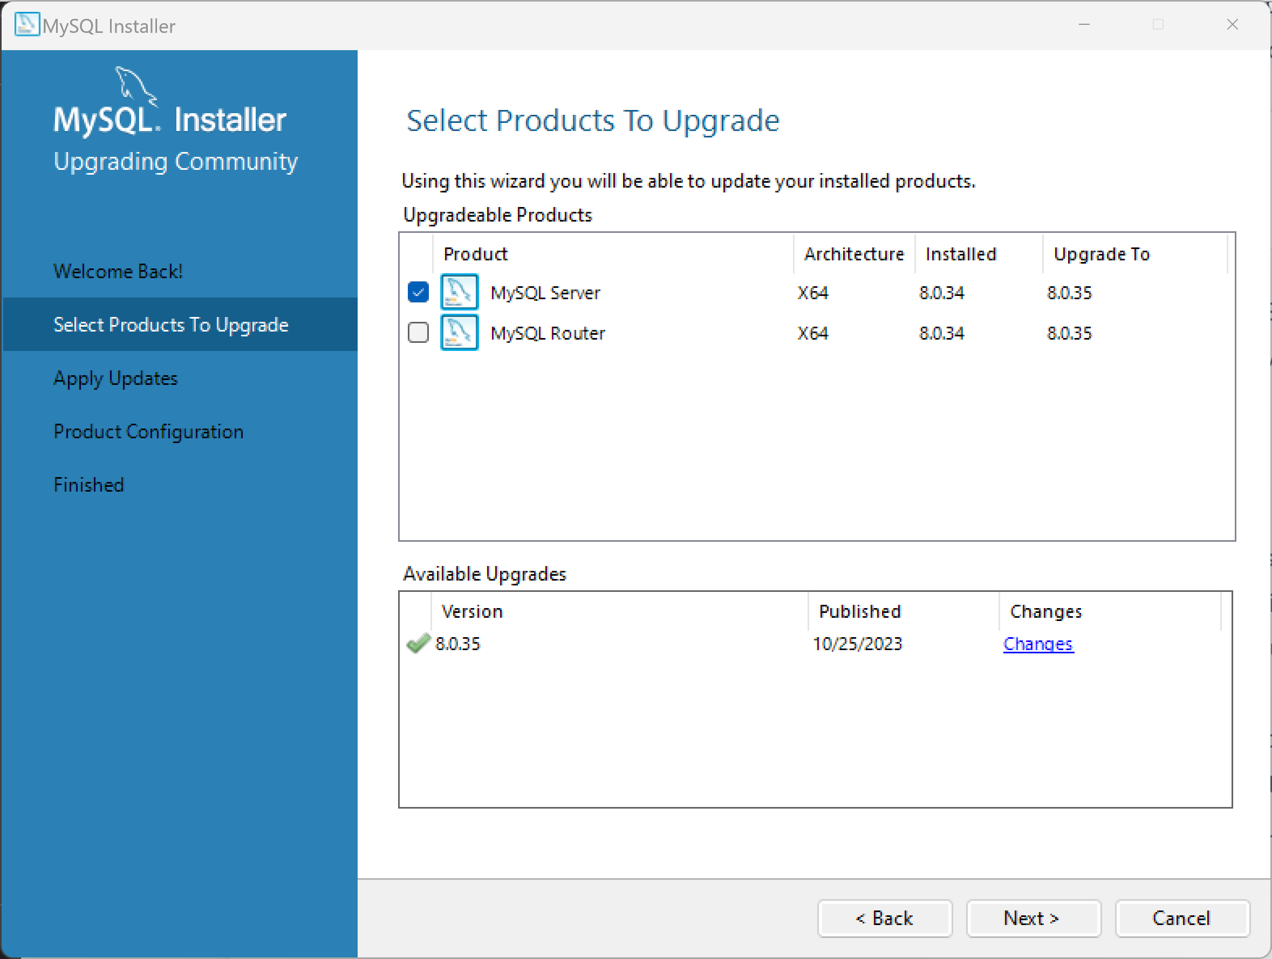
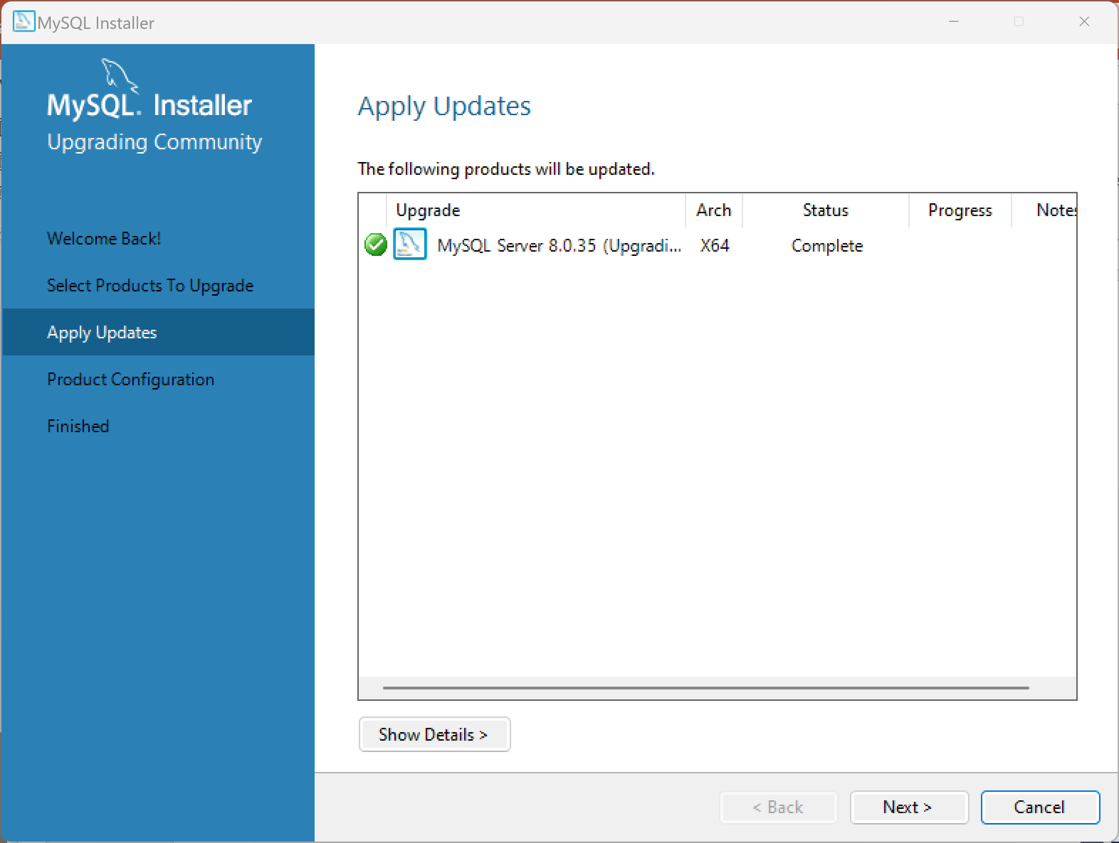
Cont…

Slide 42
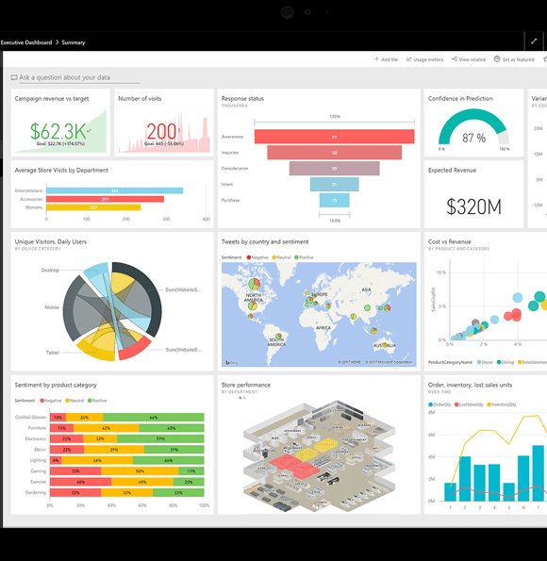

Microsoft Power BI Desktop

Slide 43
Microsoft Power BI Desktop
What is Power BI Desktop?
Power BI Desktop is a free tool for creating interactive visualizations and reports.
How to Install
Visit the Microsoft Power BI Desktop download page: Power BI Desktop.
Click on the "Download free" button to download the installer.
Run the installer and follow the installation instructions. The installation process is straightforward.
If you don’t have Microsoft Store, download from the official Microsoft Website: Microsoft Power BI

Slide 44
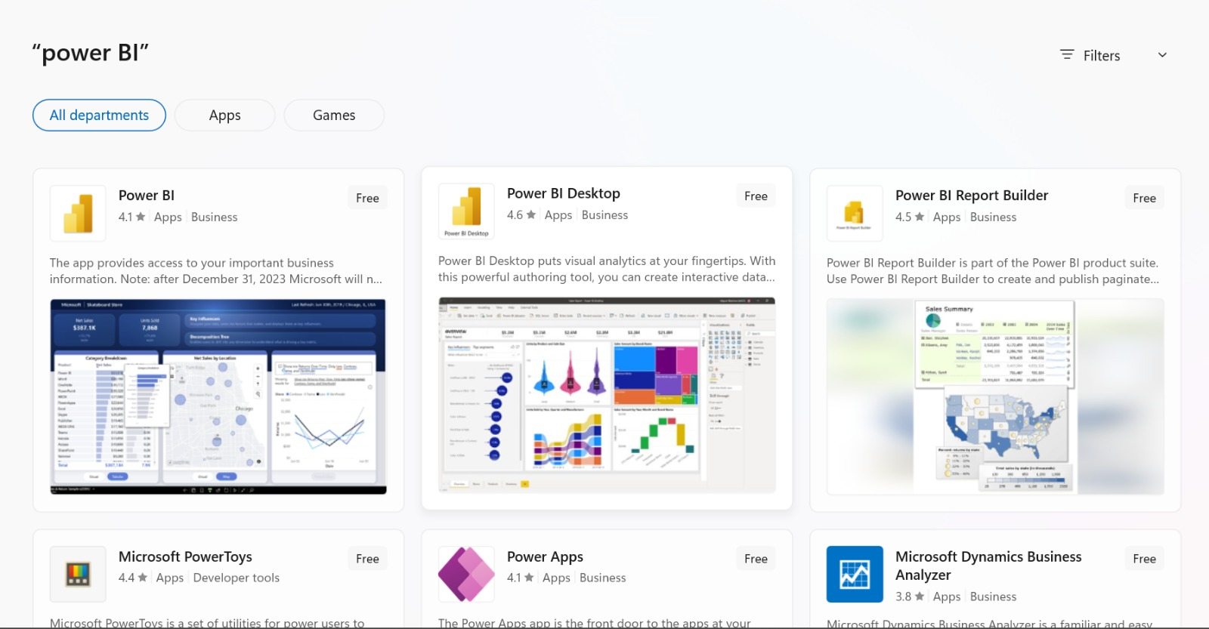
Cont…

Slide 45
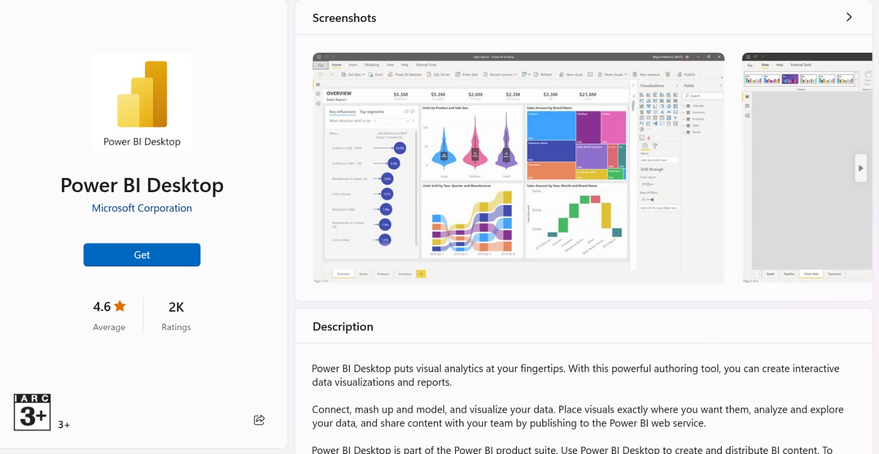
Cont…

Slide 46
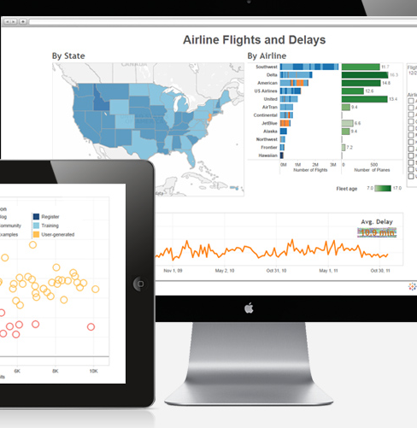

Tableau

Slide 47
Tableau
What is Tableau?
Tableau is a data visualization tool used for creating interactive and shareable dashboards.
How to Install
Tableau offers a free trial version. Visit the Tableau download page: Tableau.
Click on the "Product"--> "Tableau Desktop" button.
Follow the on-screen instructions to download and install Tableau. Note that you may need to provide some personal information during the trial registration.
Tableau gives 14 days trial period, hence install this 2-3 days before Tableau Session

Slide 48
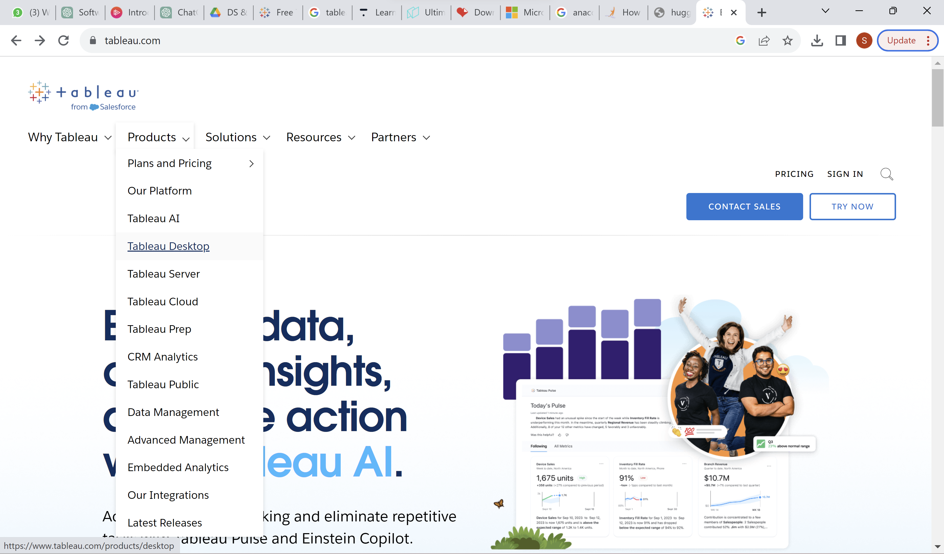
Cont…

Slide 49
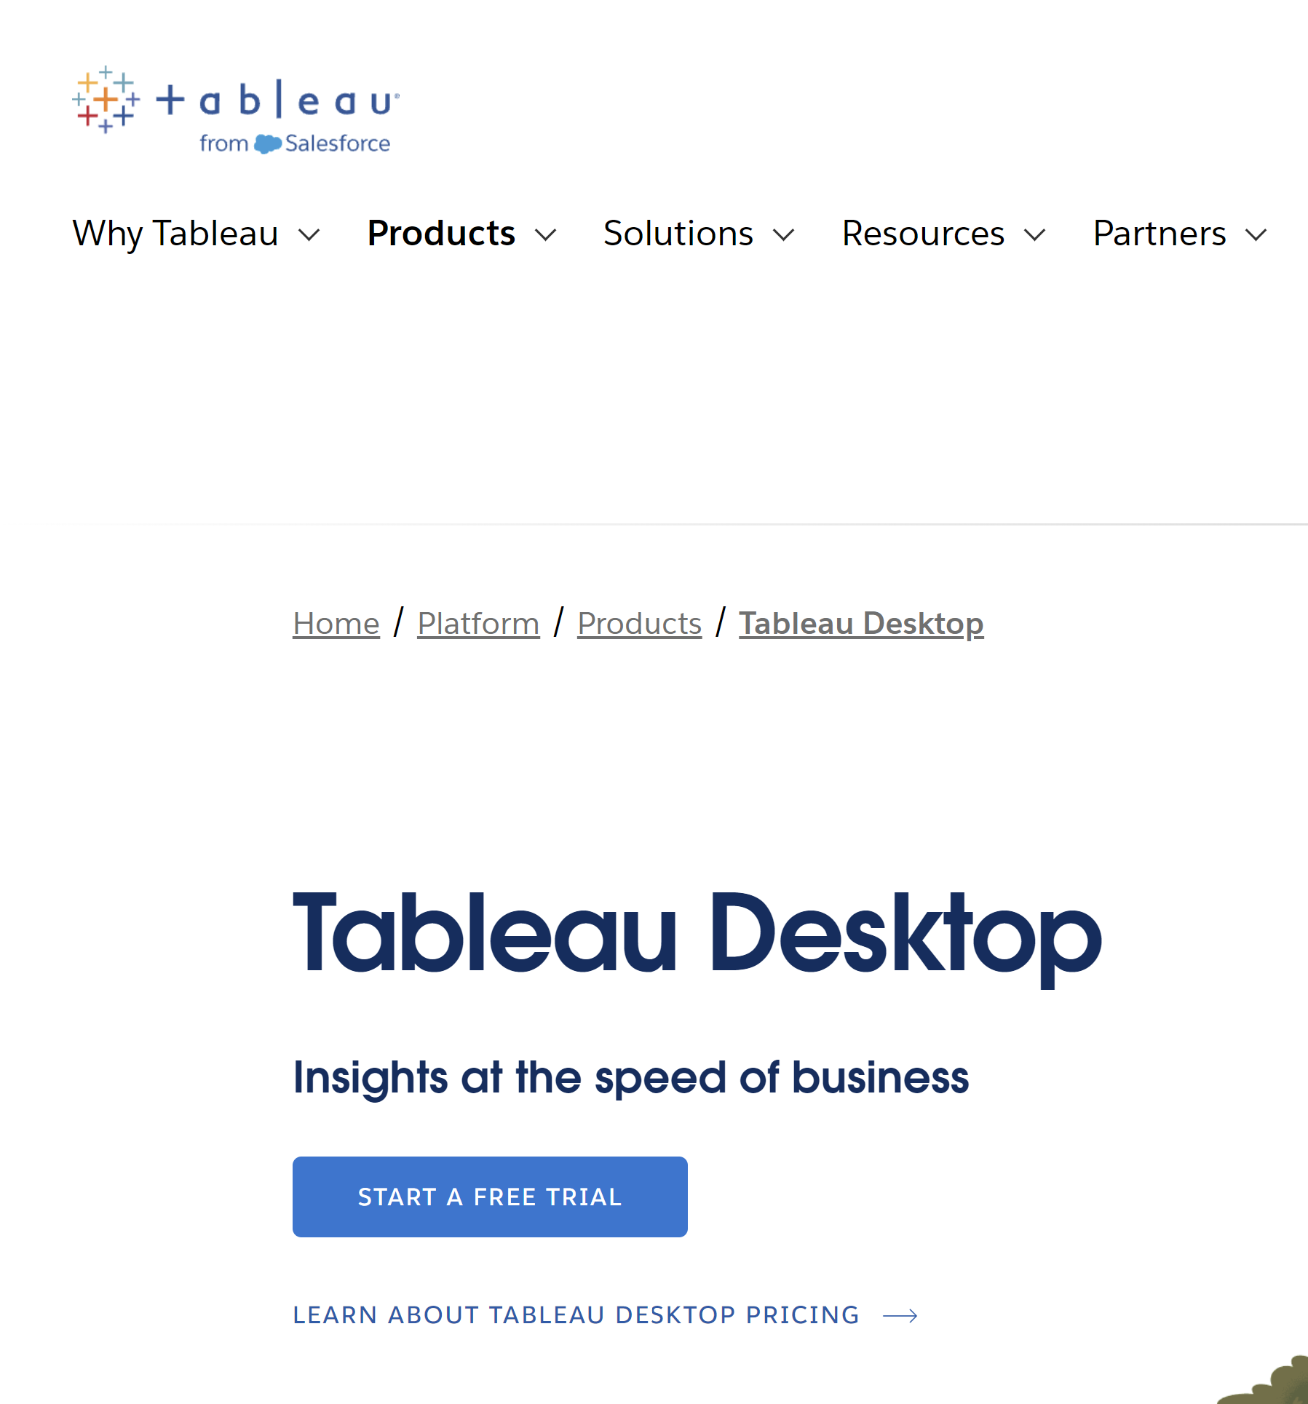
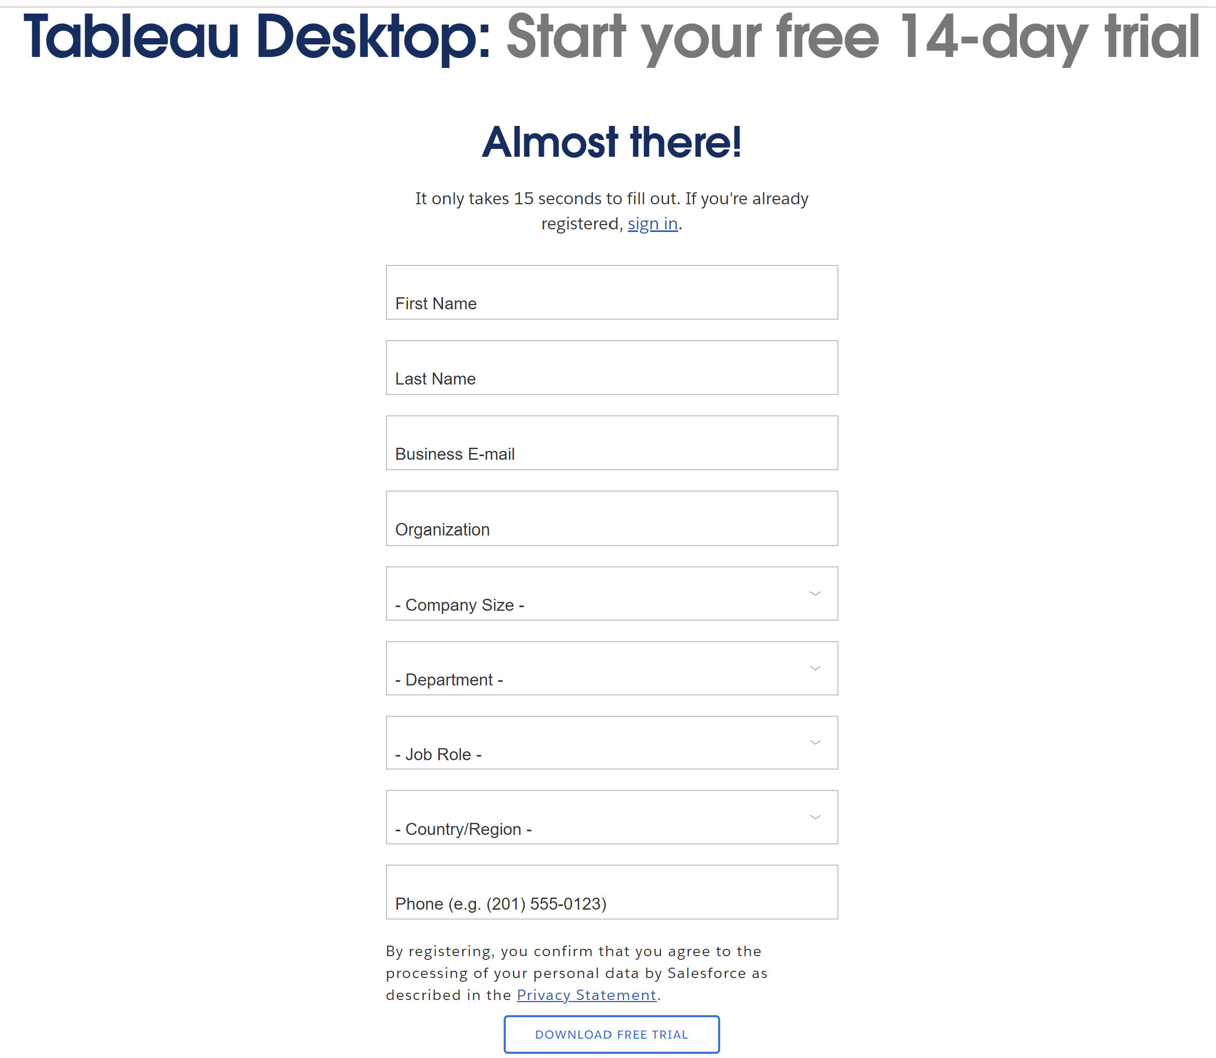
Cont…

Slide 50
Thank You

